Slide 1
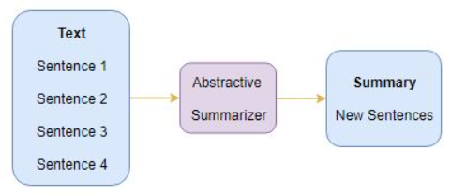
Abstractive Text Summarization
Here, we generate new sentences from the original text.
The sentences generated through abstractive summarization might not be present in the original text

Slide 2
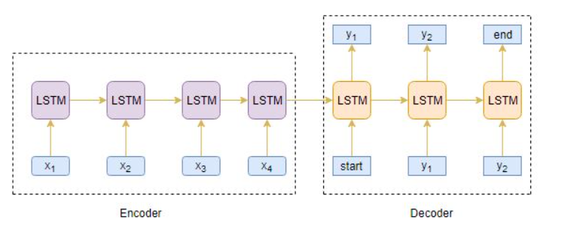
Seq2Seq
Our objective is to build a text summarizer where the input is a long sequence of words (in a text body), and the output is a short summary (which is a sequence as well). So, we can model this as a Many-to-Many Seq2Seq problem. Below is a typical Seq2Seq model architecture
There are two major components of a Seq2Seq model:
Encoder
Decoder

Slide 3
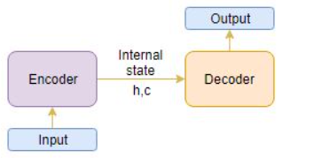
Encoder-Decoder Architecture
The input is a long sequence of words and the output will be a short version of the input sequence.
We can set up the Encoder-Decoder in 2 phases:
Training phase
Inference phase

Slide 4
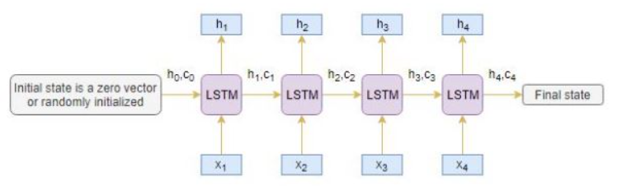
Encoder
LSTM processes the information at every timestep and captures the contextual information present in the input sequence.
The hidden state (h_{i}) and cell state (c_{i}) of the last time step are used to initialize the decoder. Remember, this is because the encoder and decoder are two different sets of the LSTM architecture.

Slide 5
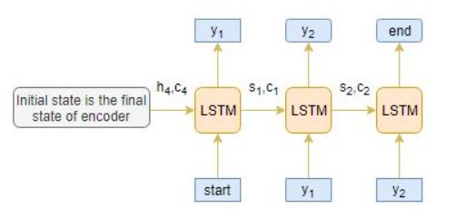
Decoder
The decoder is trained to predict the next word in the sequence given the previous word.

Slide 6
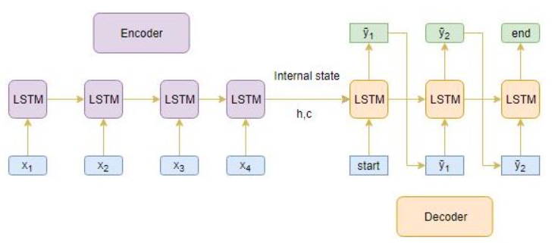
Inference Phase
After training, the model is tested on new source sequences for which the target sequence is unknown. So, we need to set up the inference architecture to decode a test sequence

